Slide 1
Module Three: Service Discovery UDDI and Service Composition BPEL

Slide 2
Service Discovery UDDI

Slide 3
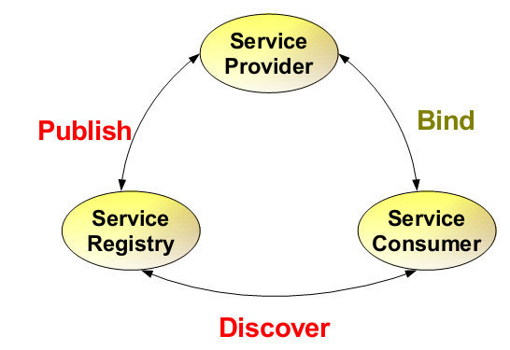
Service Architecture
UDDI(Universal Description, Discovery, and Integration) defines a scheme to publish and discover information about Web services
3

Slide 4
Web Service Protocol Stack
Searching / Publishing Web Services
Discovery UDDI
Description WSDL
Describing Web Services interface
XML Messaging XML-RPC, SOAP,XML
Transport HTTP,SMTP,FTP, BEEP
Encoding messages in XML format
Transporting XML messages between client and server

Slide 5
Using the Protocols Together – service provider perspective
Step 1:
Create core functionality
Step 2:
Create an XML-RPC or SOAP service wrapper
Step 3:
Create WSDL service description
or XML-RPC integration instructions
Step 4:
Deploy service
Step 5:
Register new service via UDDI

Slide 6
Using the Protocols Together – service request perspective
Step 1:
Find Services via UDDI
Step 2:
Retrieve Service Description File:
WSDL or XML-RPC Instructions
Step 3:
Create XML-RPC or SOAP Client
Step 4:
Invoke Remote Service

Slide 7
Service discovery
Automatic detection of devices and services offered by these devices on a computer network
Requires a common language to allow software agents to make use of one another’s services
Web Services Discovery
provides access to software systems over the Internet using standard protocols
the process of finding suitable web services to a given task

Slide 8
Service discovery in Web Service Architecture
8

Slide 9
Credit Card
Hotel
Airline
Travel Agency 1
Travel Agency 2
Travel Agency 3
…
…
Service Registry
PUBLISH
Travel Agency 1
DISCOVER
PUBLISH
PUBLISH
Travel Agency 2
Travel Agency 3
Client App
Service providers
Service requestor/consumer

Slide 10
What is UDDI?
A project to speed interoperability and adoption for web services
Standards-based specifications for service description and discovery
Shared operation of a business registry on the web
Partnership among industry and business leaders
10

Slide 11
What is UDDI?
Programmatic registration and discovery of business entities and their Web services
Based on SOAP, HTTP, XML
Registry data
Business registrations
Service type definitions
11

Slide 12
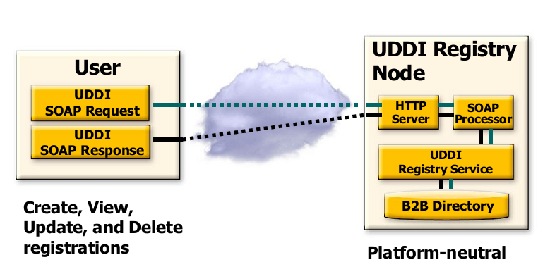
UDDI Runs “Over” SOAP
Registry data

Slide 13
Why UDDI or something like UDDI?
• Platform independent service
publication and discovery
• Enables dynamic service discovery

Slide 14
Dynamic service discovery
Credit Card
Hotel
Airline
Weather forecast 1
Weather forecast 2
Weather forecast 3
…
…
Service Registry
PUBLISH
Weather forecats1
DISCOVER
PUBLISH
PUBLISH
Client App
Weather forecast
2
Weather forecast
3
Service providers
Service requestor/consumer

Slide 15
UDDI Vision - 2000
Open industry initiative, enabling businesses to discover each other and define how they interact over the Internet
Global e-commerce driven by dynamically emerging business relations
Consumers of web services would be linked up with providers through a public or private dynamic brokerage system
Anyone needing a service would go to their service broker and select a service supporting the desired SOAP service interface, and meeting other criteria
The publicly operated UDDI node or broker would be critical for everyone
For the consumer – public or open brokers would only return services listed for public discovery by others
For service producer – matadata of index categories would be critical for effective placement

Slide 16
Recall our definition of UDDI
Programmatic registration and discovery of business entities and their Web services
Who or what uses UDDI?
16

Slide 17
What uses UDDI?
• Tool building client (Service Consumer)
• Tool publishing the service
• Application that needs dynamic binding

Slide 18
How service consumer uses UDDI
• Tool building client (Service Consumer)
– Browse or search registry
– Create a service proxy

Slide 19
How service provider uses UDDI
• Tool publishing the service
– Generates WSDL
– Construct UDDI entries

Slide 20
How application uses UDDI
• Application that needs dynamic binding
– Directly access UDDI
– Query can be pre-generated

Slide 21
UDDI Vision - 2000
Planned Adoption Phases of UDDI
• Phase 1: Experimental stage
• Phase 2: Private UDDI registry within an intranet
• Phase 3: Public UDDI registries with no coordination among them
• Phase 4: Public UDDI registries with coordination (i.e. replication)
• Phase 5: Value added registry services

Slide 22
Recall our definition of UDDI
Programmatic registration and discovery of business entities and their Web services
22

Slide 23
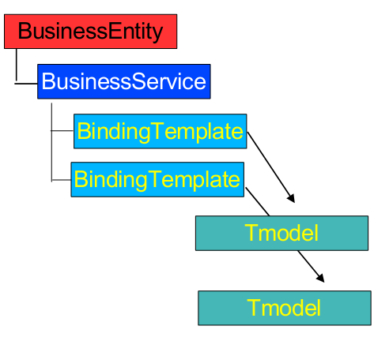
UDDI Data Model/Types
UDDI includes an XML Schema that describes four core types of information:
businessEntity
About the actual business, e.g. business name, etc.
businessService
About the services provided by the business
bindingTemplate
About how and where to access a specific service
tModel (Technical Model)
Include descriptions and pointers to external technical specifications or taxonomies

Slide 24
UDDI Data Model/Types
UDDI Business Registry
<Business>
<businessEntity>
:
:
</businessEntity>
</Business>
<Service>
<businessService>
<bindingTemplate>
:
:
</bindingTemplate>
</businessService>
</Service>
<TModel>
<tModel>
:
:
</tModel>
</TModel>
XML Schema describes these four core types of information

Slide 25
A. businessEntity
<businessEntity
businessKey=
“ba744ed0-3aaf-11d5-80dc-002035229c64”>
<name> XMethods </name>
<description> … </description>
<contacts>
<contact> … </contact>
<contact> … </contact>
</contacts>
<identifierBag> … </identifierBag>
<categoryBag> … </categoryBag>
</businessEntity>
Typical contents of businessEntity element
25

Slide 26
A. businessEntity
businessEntity element includes info about the actual business
Business name, description, contact info such as address, phone, contact person, etc.
Each business will receive a unique businessKey value when registrating to a UDDI server
e.g. businessKey of Microsoft in its UDDI server: 0076b468-eb27-42e5-ac09-9955cff462a3
The key is used to tie a business to its published services
26

Slide 27
A. businessEntity
<businessEntity
businessKey=
“ba744ed0-3aaf-11d5-80dc-002035229c64”>
<name> XMethods </name>
<description> … </description>
<contacts>
<contact> … </contact>
<contact> … </contact>
</contacts>
<identifierBag> … </identifierBag>
<categoryBag> … </categoryBag>
</businessEntity>
Typical contents of businessEntity element
27

Slide 28
A. businessEntity
Can also include other unique value(s) in identifierBag that identifies the company
UDDI supports Dun & Bradstreet D-U-N-S® Numbers and Thomas Registry Supplier IDs
e.g. Microsoft’s Dun & Bradstreet D-U-N-S® No:
08-146-6849
Businesses can also register multiple business categories in categoryBag based on standard taxonomies, e.g.
NAICS: The North American Industry Classification System provides industry classification
UNSPSC: Universal Standard Products and Service Classification provides product and service classification
28

Slide 29
A. businessEntity
Examples of identifierBag and categoryBag contents (Microsoft)
<identifierBag>
<keyedReference
tModelKey=
“uuid:8609c81e-ee1f-4d5a-b202-3eb13ad01823”
keyName=“D-U-N-S” keyValue=“08-146-6849” />
</identifierBag>
<categoryBag>
<keyedReference
tModelKey=
“uuid:c0b9fe13-179f-413d-8a5b-5004db8e5bb2”
keyName=“NAICS: Software Publisher”
keyValue=“51121” />
</categoryBag>
29

Slide 30
B. businessService
<businessService
serviceKey=
“d5921160-3e16-11d5-98bf-002035229c64”
businessKey=
“ba744ed0-3aaf-11d5-80dc-002035229c64”>
<name>XMethods Delayed Stock Quotes</name>
<description> … </description>
<bindingTemplates>
<bindingTemplate>
:
</bindingTemplate>
</bindingTemplates>
</businessService>
To tie the service with the business
Typical contents of businessService element
30

Slide 31
B. businessService
businessService element includes info about a single web service or a group of related Web services
Include the name, description and an optional list of bindingTemplates
Like businessEnitity, each businessService has a unique service key
Should specify the businessKey to relate with the business that provides that service
31

Slide 32
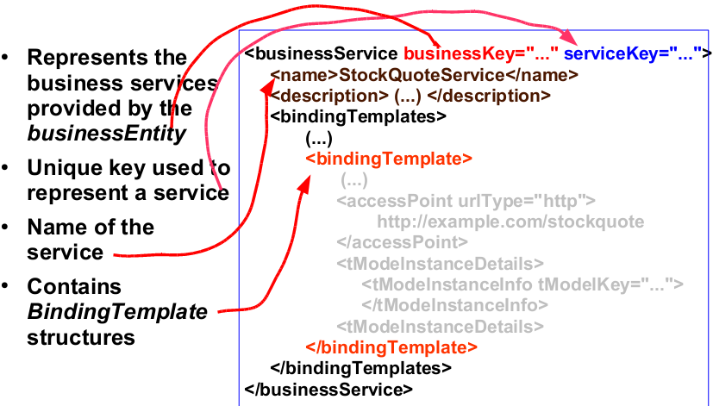
B. businessService

Slide 33
C. bindingTemplate
<bindingTemplate
serviceKey=“d5921160-3e16-11d5-98bf-002035229c64”
bindingKey=“…”>
<description xml:lang=“en”>
:
</description>
<accessPoint URLType=“http”>
http://services.xmethods.net:80/soap
</accessPoint>
<tModelInstanceDetails>
:
</tModelInstanceDetails>
</bindingTemplate>
Typical contents of bindingTemplate element
33

Slide 34
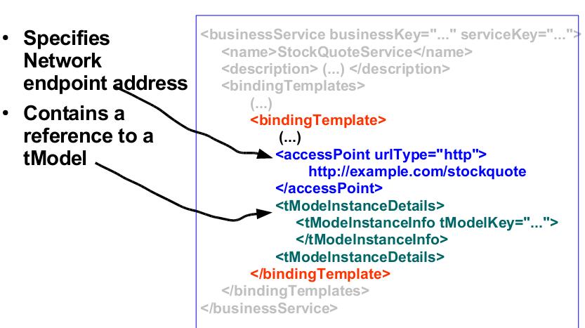
C. bindingTemplate

Slide 35
UDDI binding options
Name | Description | UUID | Details
uddi-org:smtp | Email-based service | uuid:93335D49-3EFB-48A0-ACEA-EA102B60DDC6 | Identifies a service that is invoked via SMTP email. For example, this could specify a person’s email address or an SMTP-based SOAP service.
uddi-org:fax | Fax-based service | uuid:1A2B00BE-6E2C-42F5-875B-56F32686E0E7 | Identifies a service that is invoked via fax transmissions.
uddi-org:ftp | FTP-based service | uuid:1A2B00BE-6E2C-42F5-875B-56F32686E0E7 | Identifies a service that is invoked via FTP.
uddi-org:telephone | Telephone-based service | uuid:38E12427-5536-4260-A6F9-B5B530E63A07 | Identifies a service that is invoked via a telephone call. This could include interaction by voice and/or touch-tone.
uddi-org:http | HTTP-based service | uuid:68DE9E80-AD09-469D-8A37-088422BFBC36 | Identifies a web service that is invoked via the HTTP protocol. This could reference a simple web page or a more complex HTTP-based SOAP application.

Slide 36
C. bindingTemplate
tModels are primarily used to provide pointers to external technical specifications

Slide 37
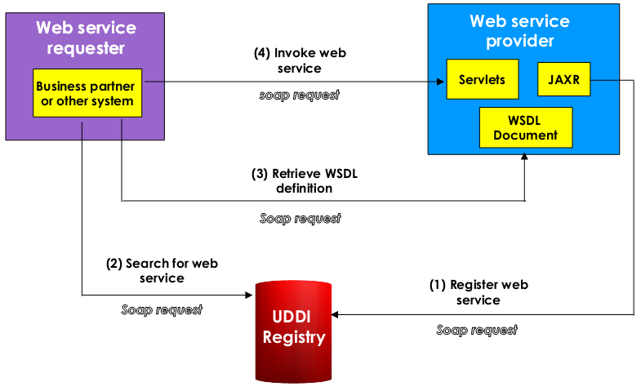
37

Slide 38
D. tModel
tModels are primarily used to provide pointers to external technical specifications (e.g wsdl)
bindingTemplate only provides info about where to access the SOAP binding, but not how to interface with it
tModel element fills this gap by providing a pointer to an external specification, such as WSDL
In fact, tModels are not reserved to Web services
tModels are used whenever it is necessary to point to any external specification, such as the D-U-N-S® no.
38

Slide 39
Service Type Registration
Pointer to the namespace where service type is described
What programmers read to understand how to use the service
Identifier for who published the service
Identifier for the service type registration
called a tModelKey
Used as a signature by web sites that implement those services
39

Slide 40
tModel Example
<tModel authorizedName="..." operator="..." tModelKey="...">
<name>StockQuote Service</name>
<description xml:lang="en">
WSDL description of a standard stock quote service interface
</description>
<overviewDoc>
<description xml:lang="en"> WSDL source document. </description>
<overviewURL> http://stockquote-definitions/stq.wsdl </overviewURL>
</overviewDoc>
<categoryBag>
<keyedReference tModelKey="UUID:..."
keyName="uddi-org:types"
keyValue="wsdlSpec"/>
</categoryBag>
</tModel>

Slide 41
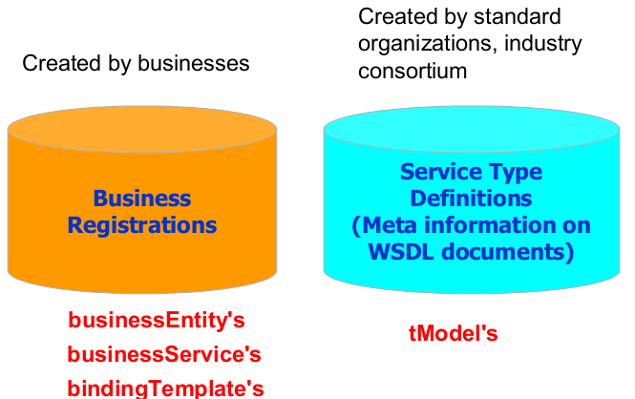
Registry Data

Slide 42
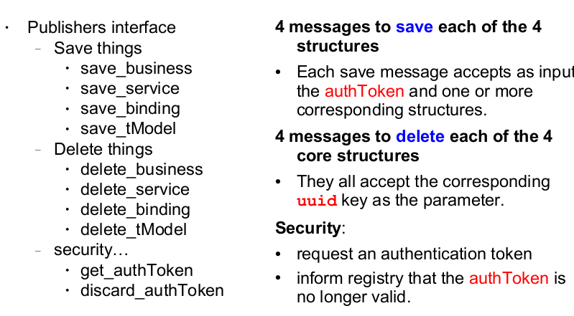
Publishing Services

Slide 43
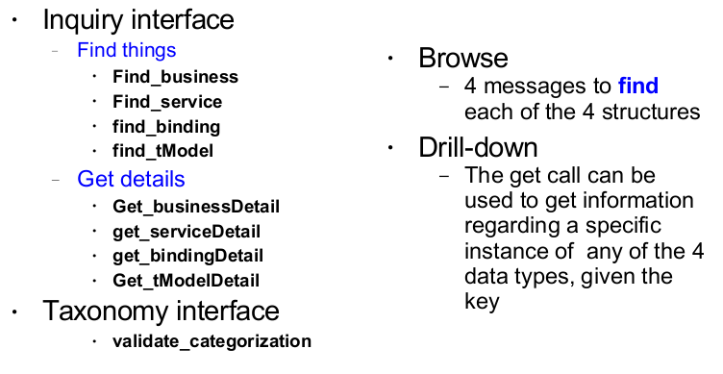
Programmer's API: Service Discovery

Slide 44
UDDI Runs “Over” SOAP
SSL for save_xxx
APIs
Registry data

Slide 45
SOAP Message Example for get_serviceDetail request
<Envelope>
<Body>
<get_serviceDetail generic="1.0">
<serviceKey>6FD77EF6-E7D6-6FF6-1E41-EBC80107D7B5
</serviceKey>
</get_serviceDetail>
</Body>
</Envelope>

Slide 46
SOAP Message Example for get_serviceDetail response
<Envelope>
<Body>
<serviceDetail generic="1.0" operator="XMethods">
<businessService serviceKey="6FD77EF6-E7D6-6FF6-1E41-EBC80107D7B5"
businessKey="D1387DB1-CA06-24F8-46C4-86B5D895CA26">
<name>Currency Exchange Rate</name>
<description>Endpoint for service</description>
<description>IMPLEMENTATION: glue</description>
<description>CONTACT EMAIL: support@xmethods.net</description>
<bindingTemplates>
<bindingTemplate bindingKey="0036DEBC-2F1B-EB84-09E2-3A4332C3E8B4"
serviceKey="6FD77EF6-E7D6-6FF6-1E41-EBC80107D7B5">
<description>SOAP binding</description>

Slide 47
<accessPoint URLType="http">http://services.xmethods.net:80/soap</accessPoint>
<tModelInstanceDetails>
<tModelInstanceInfo tModelKey="uuid:D784C184-99B2-DA25-ED45-3665D11A12E5"/>
</tModelInstanceDetails>
</bindingTemplate>
</bindingTemplates>
</businessService>
</serviceDetail>
</Body>
</Envelope>

Slide 48
UDDI discussion and review

Slide 49

Open Question
Points: 10
What are your impressions after learning about UDDI technology?
Is UDDI registry being used as intended?
What are the problems with this approach to a Web services discovery?
Answer

Slide 50
Issues of UDDI
How do you know if the data you get is valid, legitimate, and up to date?
How do you measure quality of data?
How do you make sure only the qualified entities register their service information (authentication)?
How do you provide access control to the data in the registry?
How do you synchronize the data in multi-registry environment?

Slide 51
UDDI wide adoption failure
2006 - IBM, Microsoft and SAP closed their public UDDI nodes
2007 – the group defining UDDI, the OASIS UDDI Specification Technical Committee has been closed
2010 – Microsoft announce removing UDDI services from future versions of the Windows Server operating system
Moved this capability to BizTalk Server
2016 – removed UDDI Services from BizTalk Server

Slide 52
Open Question
Points: 10
In a 2000 vision, the publicly operated UDDI node or broker would return services listed for public discovery by others. We now know that this vision has failed. Do you know about an alternative way to implement and use UDDI registries?
Answer

Slide 53
UDDI implementations
Public federated network of UDDI registries available on the Internet
UDDI registry is a part of the global federated network
Private UDDI registries developed by companies or industry groups
UDDI registry is privately owned and operated
Allows members of the company or the industry group to share and advertise services amongst themselves
In common: Web services API for publishing and locating businesses and services advertised within the UDDI registry

Slide 54
UDDI alternative use
Support SOA governance within an organization
Offering a standardized way to
catalog company matadata
categorize it in multiple dimensions
Used to dynamically bind client systems to implementations

Slide 55
Example – UDDI registry in a large enterprise
A “Widget, Ltd” company has an existing application called “OurEmployeesHR” that provides telephone numbers and human resources (HR) information about employees
You are a developer in the same company. You want to write an application called “Procurement” for a procurement function that also needs to provide HR information to the supplier
Your application needs to give the supplier access to the employee account codes after the employee provides a name or serial number

Slide 56
Open Question
Points: 10
Consider scenario before the Web services. Can you reuse the existing “OurEmployeesHR” application while writing your own “Procurement” application? What problems do you see? (you cannot use Web services to help you)
Answer

Slide 57
Example (cont)
Before the web services
The developer does not know about the similar application
The developer knows about the application but cannot reuse it because of technical barriers
The developer knows about the application and reuses it, but only after significant time and negotiation

Slide 58
Open Question
Points: 10
Now consider a scenario where the “Widget, Ltd” decides to use Web services. Describe how a developer of “Procurement” application can reuse “OurEmployeesHR” application.
What steps must be taken? How is UDDI used here? What would be the benefits for the developer and for the company?
Answer

Slide 59
Example (cont)
With UDDI
“OurEmployeesHR” application is turned into a web service and published to the registry
The developer can search for the web service and reuse the existing technical component in their new application for the supplier in minutes
The developer saves the time and gets the application running sooner
Increased efficiency
Saved time and money

Slide 60
Even though UDDI isn’t widely used, the concepts behind it are still very relevant

Slide 61
Service Composition BPEL

Slide 62
What is service composition?
Service composition allows developers to “compose” services that exchange SOAP messages and define their interfaces into an aggregate solution.
The aggregate is a composed Web service or a so-called composite Web service.

Slide 63
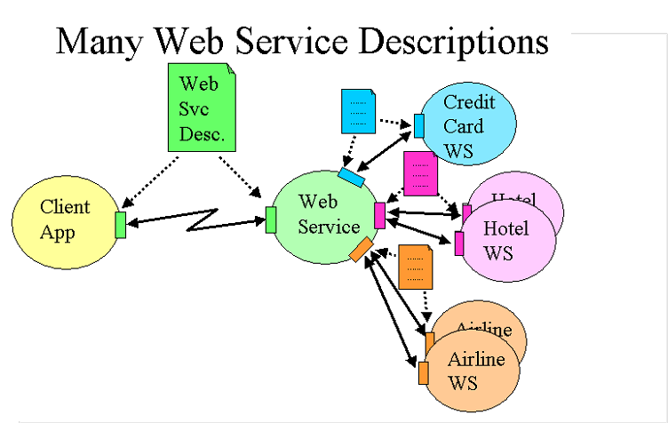
Composite Web Service example
Multiple Web services may be required to collaborate with each other to form a composite Web service.
A travel booking Web service may include three sub-processes: flight reservation, hotel reservation, and credit card payment.
These three sub-processes may be performed by three individual Web services provided by corresponding service providers.
The travel booking Web service thus becomes a composite Web service involving three collaborative Web services.

Slide 64
Business Process
Business companies are driven by underlying business processes
Business process is a set of activities that are coordinated to achieve a certain business goal.
Business process is a structured and measurable set of activities that consume certain resources and are designed to produce the specified output for a particular business requirement.

Slide 65
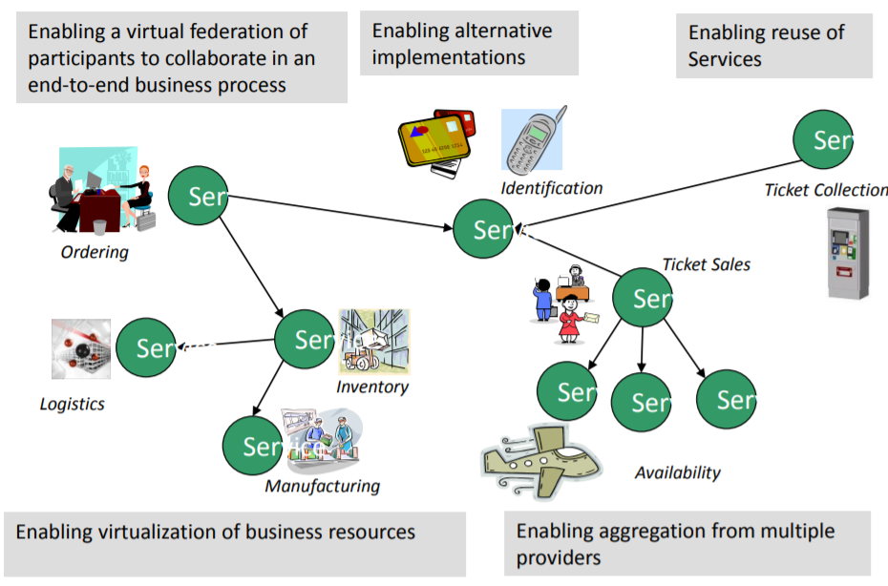
Motivation - ENABLE FLEXIBLE, FEDERATED BUSINESS PROCESSES
Enable flexible, federated business processes

Slide 66
What is BPEL?
The Business Process Execution Language for Web Services is such a flow representation developed to facilitate coordination of Web services into a comprehensive business process.
In short: BPEL is a business process language that can be used to represent composite services.

Slide 67
OrderService business process example
The customer calls the submitPO operation with a message PurchaseOrderMessage;
The supplier calls the submitPayment operation with a message paymentRequestMessage and receives a message paymentResponseMessage;
The supplier calls the submitShipping operation with a message shippingRequestMessage and receives a message shippingResponseMessage;
The supplier returns to the customer a message ResultMessage.

Slide 68
BPEL definition sections
Partner link definition
Variables
Process definition

Slide 69
An example BPEL definition for a business order process

Slide 70
An example BPEL definition for a business order process

Slide 71
An example BPEL definition for a business order process

Slide 72
Partner link definition section
Involved business parties are grouped by a tag partnerLinks
Each partner link is characterized by a tag partnerLink.
Three partner links are defined: purchasing, payment, and shipping.
The myRole/partnerRole attribute of a partner specifies how the partner and the process interact given the partnerLinkType.
The myRole attribute refers to the role in the serviceLinkType that the process will play
The partnerRole specifies the role that the partner will play
In our example: for the partner payment, the supplier acts as a paymentRequestor and the payment service provider offers the service; for the partner shipping, the supplier acts as a shippingRequestor and the shipping service provider offers the service.

Slide 73
Cont.

Slide 74
The section of variables
Defines the data variables used by the business process, based upon their definitions in terms of WSDL message types, XML Schema simple types, or XML Schema elements.
For example, the variable PurchaseOrder refers to the PurchaseOrderMessage defined in the WSDL document; Result refers to ResultMessage; and ShippingRequest refers to ShippingRequestMessage.
Variables allow processes to maintain state data and process history based on messages exchanged

Slide 75
Cont.

Slide 76
Process definition section – receive
The structure of the main processing section is defined by a pair of sequence tags, indicating that four activities are performed sequentially: receive, payment, shipping, and reply.
The first activity is a receive activity, which accepts incoming customer messages.
The definition of a receive activity includes the partner who sends the message, the port type, and the operation of the process to which the partner is targeting this message.
Based on this information, once the process receives a message, it searches for an active receive activity that has a matching quadruple <partnerLink, portType, operation, variable> and hands it the message.
In our example, the receive activity invokes the submitPurchaseOrder operation from the purchaseOrderPT portType with the variable PurchaseOrder (i.e., PurchaseOrderMessage).

Slide 77
Cont.

Slide 78
Process definition section - invoke
After the receive activity, the process invokes two Web services sequentially, each being delimited using an invoke tag.
First, the process invokes the operation submitPayment from the portType paymentPT, with an input message PaymentRequest (i.e., PaymentRequestMessage) and an output message PaymentResponse (i.e., PaymentResponseMessage).
Then the process invokes the operation submitShipping from the portType shippingPT, with an input message ShippingRequest (i.e., ShippingRequestMessage) and an output message ShippingResponse (i.e., ShippingResponseMessage).

Slide 79
Cont.

Slide 80
Process definition section - reply
The fourth and the last activity is a reply activity, which allows the business process to send a message in reply to the customer.
Once a reply activity is reached, the quadruple <partnerLink, portType, operation, variable> is used to send the result back to the customer.
In our example, the reply activity invokes the getResult operation from the purchaseOrderPT portType with the variable Result (i.e., ResultMessage).
The combination of a pair of receive and reply forms a request-response operation on the WSDL portType for the process
In this example submitPurchaseOrder operation in the portType purchaseOrderPT.

Slide 81
Module 3 Summary
Service discovery
Service composition

Slide 82
Module 1-3 review

Slide 83
Open Question
Points: 10
What are the names of the three actors in web services architecture?
Open Question is only supported on Version 2.0 or newer.
Answer

Slide 84
Web Service Roles
Service
Registry
Service
Requestor
Service
Provider

Slide 85
Open Question
Points: 10
What is the purpose of web service protocol stack?
Open Question is only supported on Version 2.0 or newer.
Answer

Slide 86
Web Service Protocol Stack
Searching / Publishing Web Services
Discovery
UDDI
Description
WSDL
Describing Web Services interface
XML Messaging
XML-RPC, SOAP, Custom XML
Transport
HTTP, SMTP, FTP, BEEP
Encoding messages in XML format
Transporting XML messages between client and server

Slide 87
Open Question
Points: 10
How service requestor uses the protocols in web service protocol stack?
Open Question is only supported on Version 2.0 or newer.
Answer

Slide 88
Using the Protocols Together – service requestor perspective
Step 1:
Find Services via UDDI
Step 2:
Retrieve Service Description File:
WSDL or XML-RPC Instructions
Step 3:
Create XML-RPC or SOAP Client
Step 4:
Invoke Remote Service

Slide 89
Service requestor
Service
Registry
Discover Services
Retrieve Service
Description
Provider
Requestor
Service Description
Service
Invoke Remote
Service

Slide 90
Open Question
Points: 10
How service provider uses the protocols in web service protocol stack?
Open Question is only supported on Version 2.0 or newer.
Answer

Slide 91
Using the Protocols Together – service provider perspective
Step 1:
Create core functionality
Step 2:
Create an XML-RPC or SOAP service wrapper
Step 3:
Create WSDL service description
or XML-RPC integration instructions
Step 4:
Deploy service
Step 5:
Register new service via UDDI

Slide 92
Service Provider
Service
Registry
Register Services
Retrieve Service
Description
Service publisher
Customers
Service Description
Service
Invoke Remote
Service

